Slide 1
Machine Learning Basics for Plasma Physics
Aidan Crilly
Code at https://github.com/aidancrilly/ML_Lecture_Demos

Slide 2
What to expect?
This talk aims to:
Introduce key machine learning (ML) concepts and language
Relate ML techniques to more familiar numerical methods
Introduce ML techniques which have been used to Plasma Physics research
Hopefully, be a jumping off point to learning more about ML useful to your own research
This talk does not aim to:
Discuss ML research, we will discuss ML in research
Be an authority on ML, it would be great if this could become a discussion on use cases

Slide 3
Overview
What is Machine Learning?
Regression & Classification
Parametric Regressors (Non-neural)
Ordinary and Non-Linear Least Squares
Bayesian Inference
Non-Parametric Regressors
Gaussian Processes
Neural Networks

Slide 4
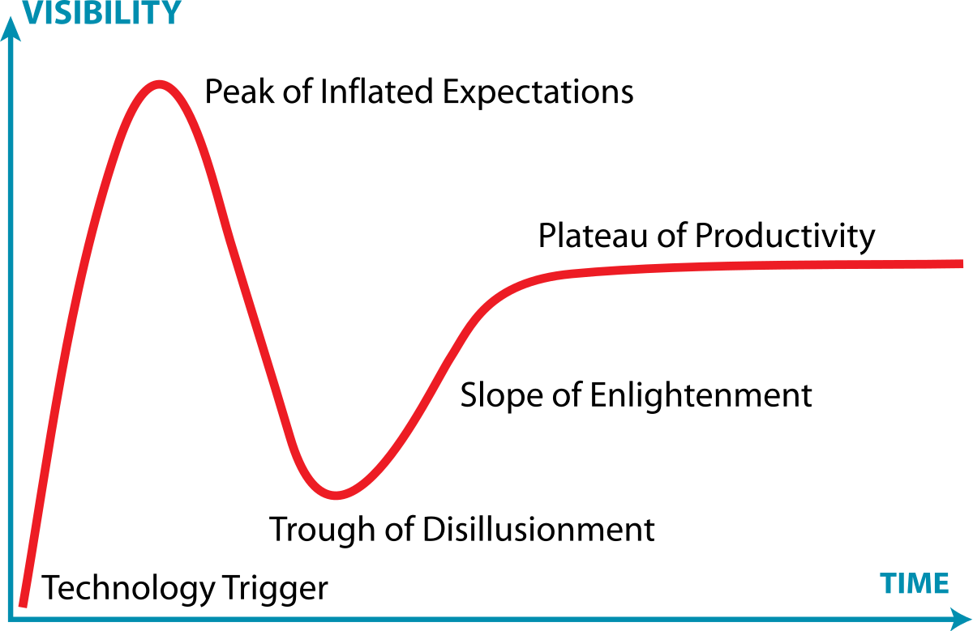
What is “Machine Learning”?
Numerical modelling which adapts parameters algorithmically to learn the relationship between input and output data
Parameter evolution often posed as an optimisation problem (nothing new!)
User often must select ‘hyper-parameters’ which change aspects of the machine learning algorithm

Slide 5

Regression & Classification
Two of the core ML tasks are regression and classification
Classification is the task of placing data within a finite number of sets, for example determining if a photo contains a cat or not
Regression is the task of estimating the functional relationship between a set of input and output variables, for example fitting a straight line to (x,y) data pairs

Slide 6
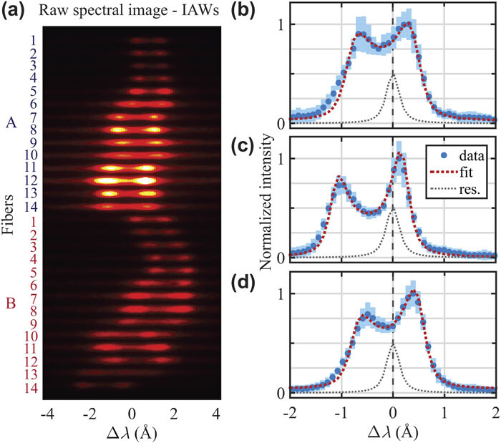
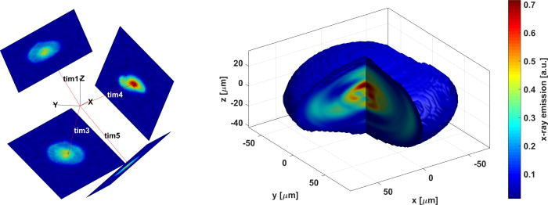
Regression
Regression problems are ubiquitous in Plasma Physics data analysis
An entirely non-exhaustive list of examples:
Image reconstruction and 3D tomography
Thomson scattering spectra
Fusion neutron spectroscopy
X-ray line spectroscopy
Typically reduced models with small number of parameters are used to fit each diagnostic signal separately

Slide 7
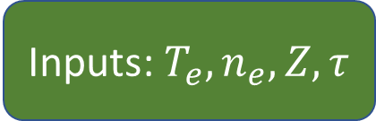
Parametric Regressors
The most common form of regression includes a ‘physics-based’ model which maps input physical parameters (e.g. temperature and density) to the expected diagnostic signature
For example, X-ray line spectroscopy
The ‘optimal’ set of parameters which match the observed data are sought in a forward-fit process
Inputs: $T_{e},n_{e},Z,τ$
Atomic Physics Model
Data-model consistency

Slide 8
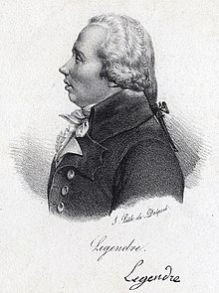
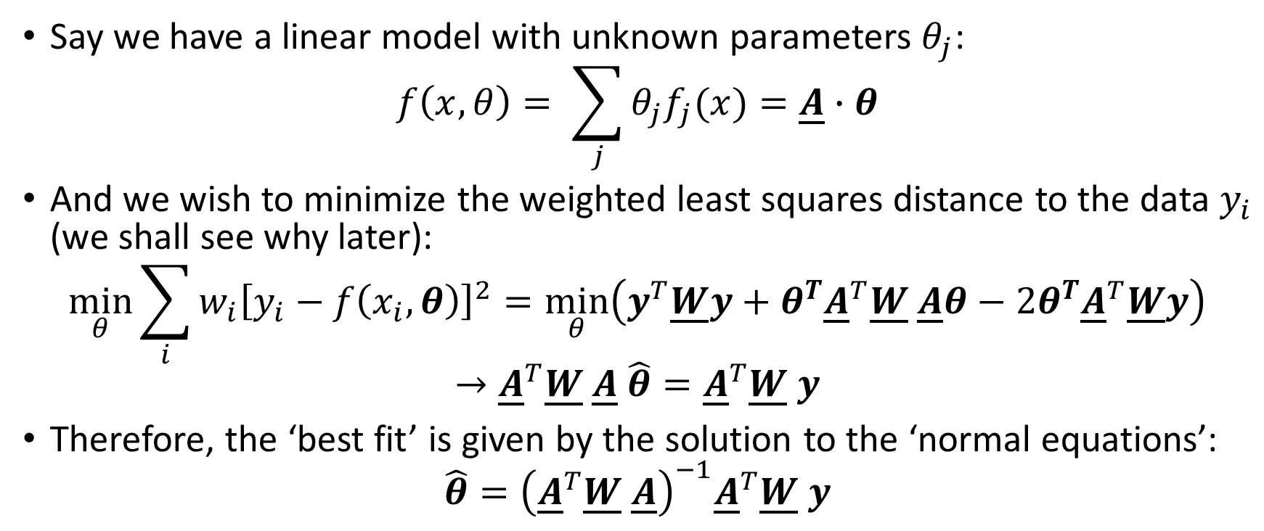
Ordinary Least Squares
Say we have a linear model with unknown parameters $θ_{j}$:
$$f\left(x,θ\right)= \sum_{j}{θ_{j}f_{j}(x)}=\underline{A}∙θ$$
And we wish to minimize the weighted least squares distance to the data $y_{i}$ (we shall see why later):
$$\min_{θ}{\sum_{i}{{w_{i}\left[y_{i}−f\left(x_{i},θ\right)\right]}^{2}}}=\min_{θ}\left(y^{T}\underline{W}y+θ^{T}{\underline{A}}^{T}\underline{W} \underline{A}θ−2θ^{T}{\underline{A}}^{T}\underline{W}y\right)$$
$$→{\underline{A}}^{T}\underline{W} \underline{A} \hat{θ}={\underline{A}}^{T}\underline{W} y$$
Therefore, the ‘best fit’ is given by the solution to the ‘normal equations’:
$$\hat{θ}={\left({\underline{A}}^{T}\underline{W} \underline{A}\right)}^{−1}{\underline{A}}^{T}\underline{W} y$$

Slide 9
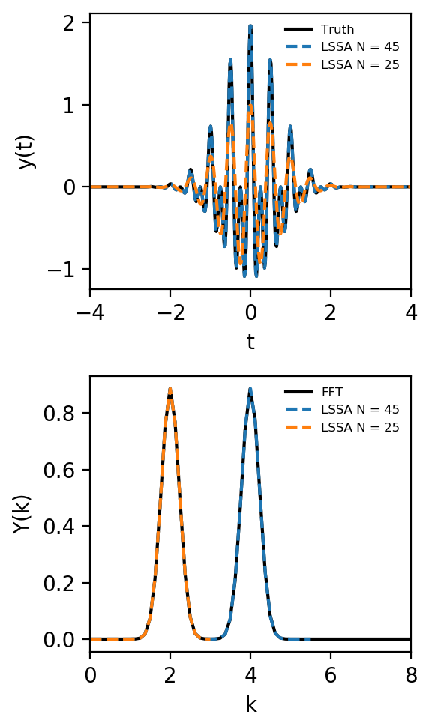

Practical example
Least-squares spectral analysis (LSSA) is a linear regression problem
Can handle unequally spaced data, uncertainties and limit the mode number
See Lomb-Scargle method
Not formally a Discrete Fourier Transform
$$f\left(x,θ\right)= \sum_{j=0}^{N}{θ_{j}\cos\left[\frac{πj}{T}t\right]}=\underline{A}∙θ$$
$$\hat{θ}={\left({\underline{A}}^{T} \underline{A}\right)}^{−1}{\underline{A}}^{T}y$$

Slide 10
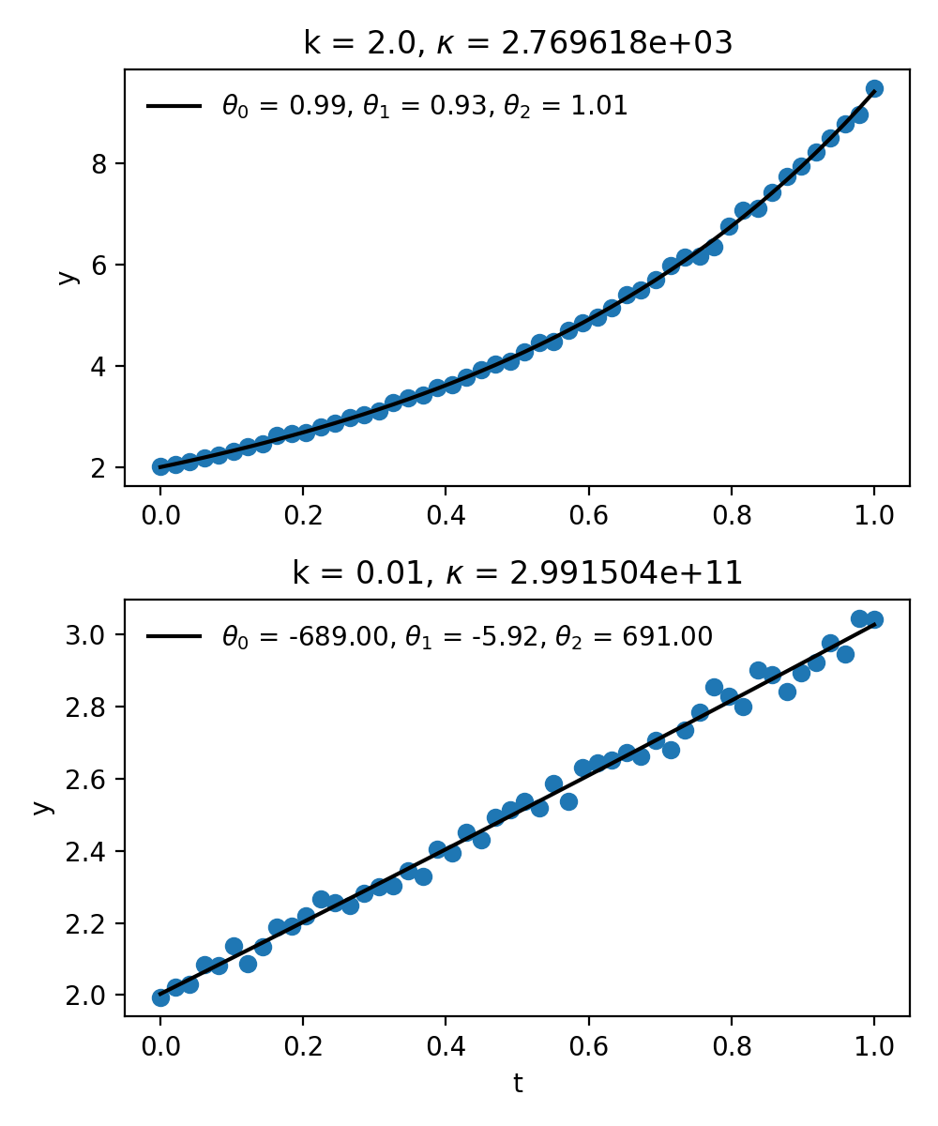
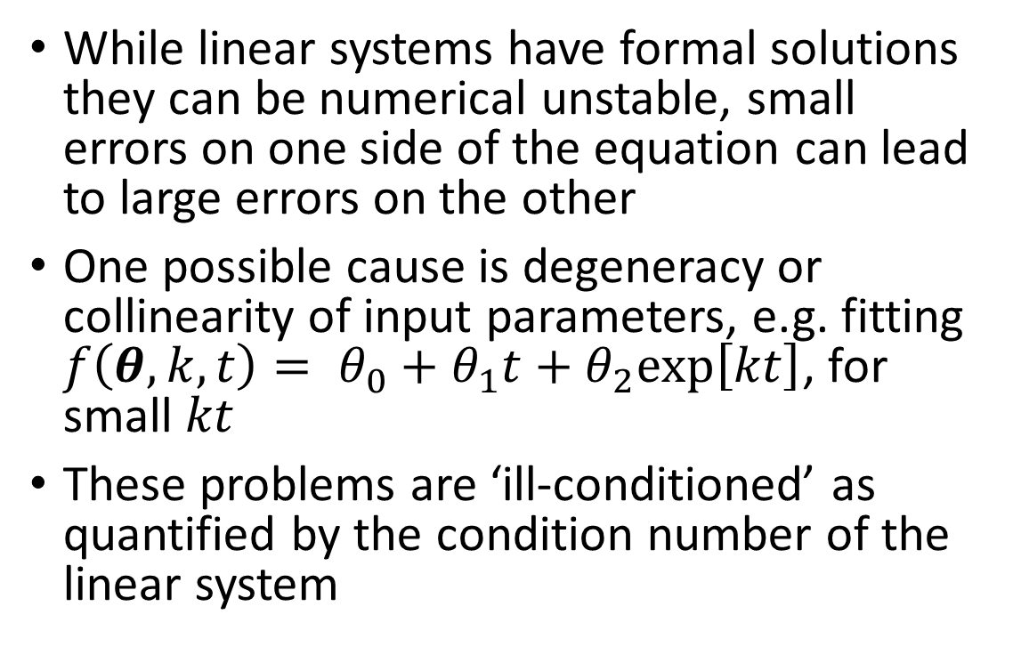
Ill-conditioned or ill-posed problems
While linear systems have formal solutions they can be numerical unstable, small errors on one side of the equation can lead to large errors on the other
One possible cause is degeneracy or collinearity of input parameters, e.g. fitting $f\left(θ,k,t\right)= θ_{0}+θ_{1}t+θ_{2}\text{exp}\left[kt\right]$, for small $kt$
These problems are ‘ill-conditioned’ as quantified by the condition number of the linear system

Slide 11
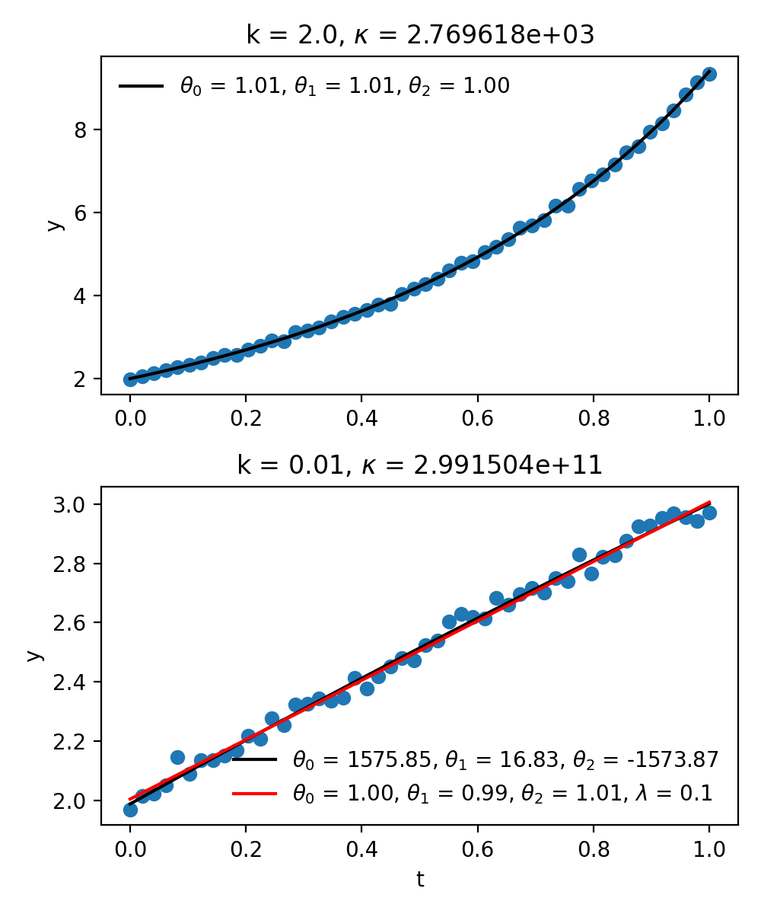
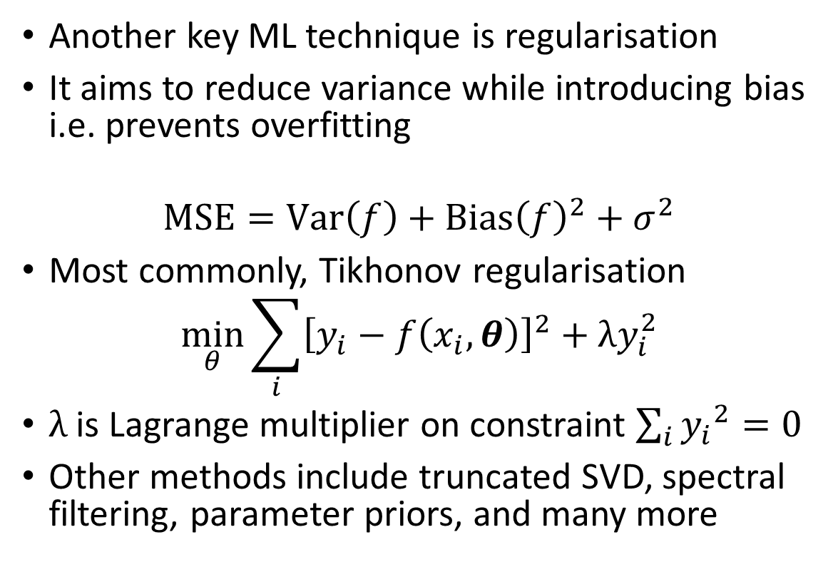
Regularisation
Another key ML technique is regularisation
It aims to reduce variance while introducing bias i.e. prevents overfitting
$$\text{MSE}=\text{Var}\left(f\right)+{\text{Bias}\left(f\right)}^{2}+σ^{2}$$
Most commonly, Tikhonov regularisation
$$\min_{θ}{\sum_{i}{{\left[y_{i}−f\left(x_{i},θ\right)\right]}^{2}}}+λy_{i}^{2}$$
$λ$ is Lagrange multiplier on constraint $\sum_{i}{{y_{i}}^{2}}=0$
Other methods include truncated SVD, spectral filtering, parameter priors, and many more

Slide 12
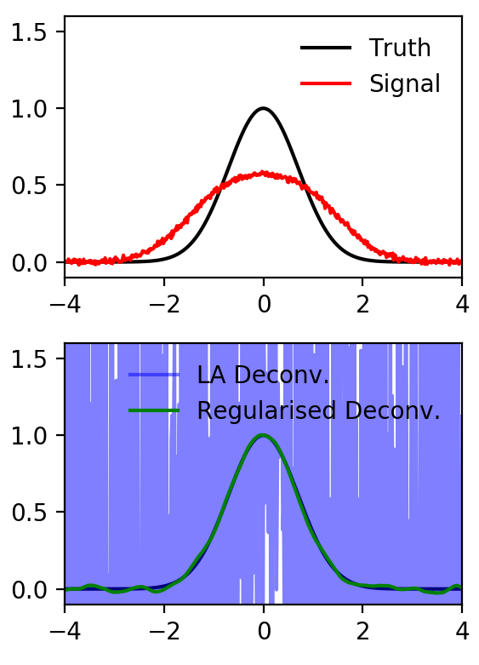
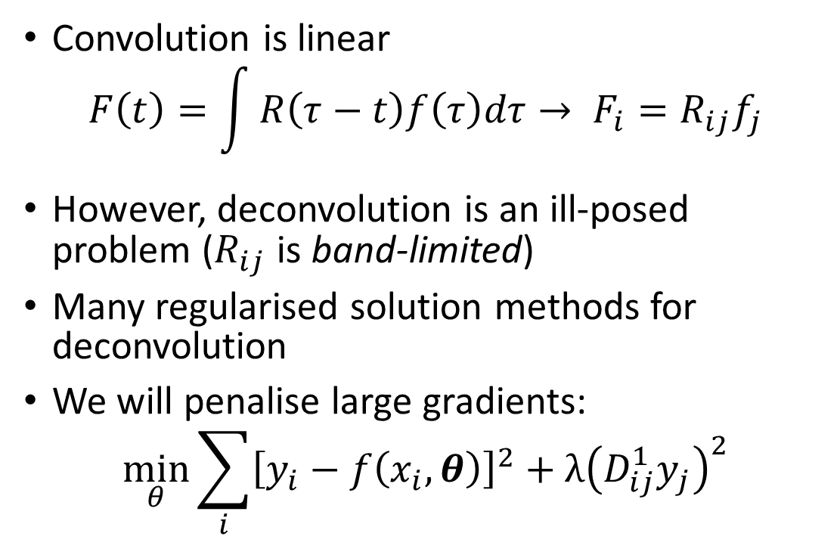
Deconvolution and Regularisation
Convolution is linear
$$F\left(t\right)=\int{R\left(τ−t\right)f\left(τ\right)dτ}→ F_{i}=R_{ij}f_{j}$$
However, deconvolution is an ill-posed problem ($R_{ij}$ is band-limited)
Many regularised solution methods for deconvolution
We will penalise large gradients:
$$\min_{θ}{\sum_{i}{{\left[y_{i}−f\left(x_{i},θ\right)\right]}^{2}}}+λ{\left(D_{ij}^{1}y_{j}\right)}^{2}$$
First order finite difference

Slide 13
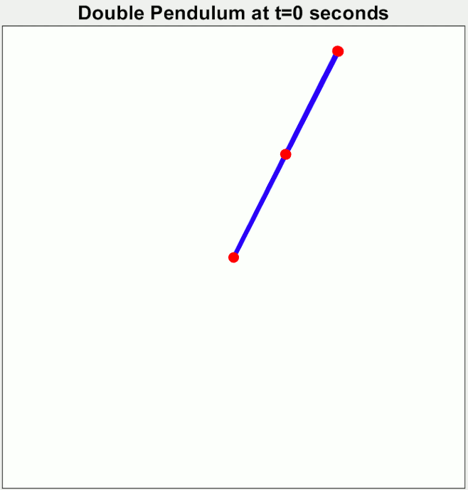
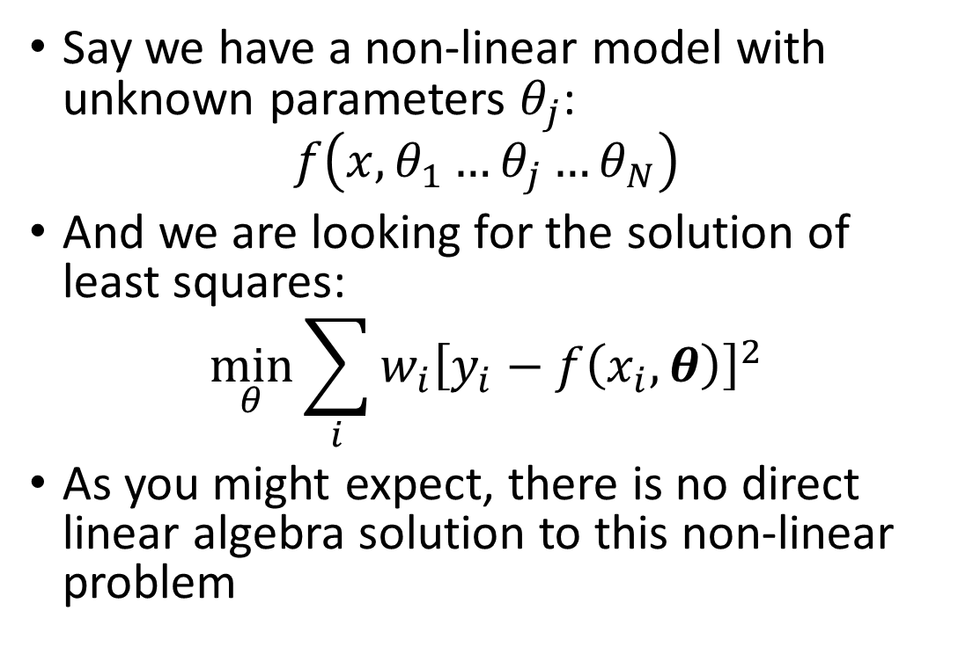
Non-Linear Least Squares
Say we have a non-linear model with unknown parameters $θ_{j}$:
$$f\left(x,θ_{1}…θ_{j}…θ_{N}\right)$$
And we are looking for the solution of least squares:
$$\min_{θ}{\sum_{i}{{w_{i}\left[y_{i}−f\left(x_{i},θ\right)\right]}^{2}}}$$
As you might expect, there is no direct linear algebra solution to this non-linear problem

Slide 14
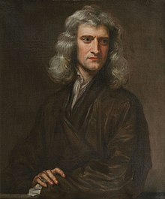
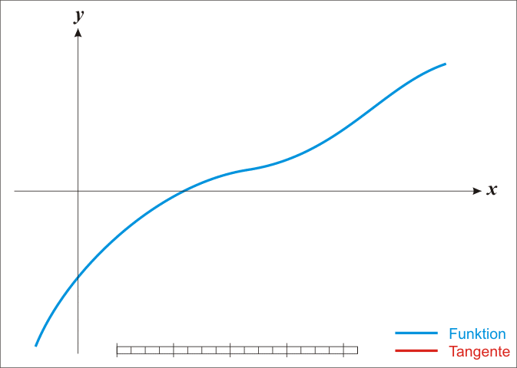
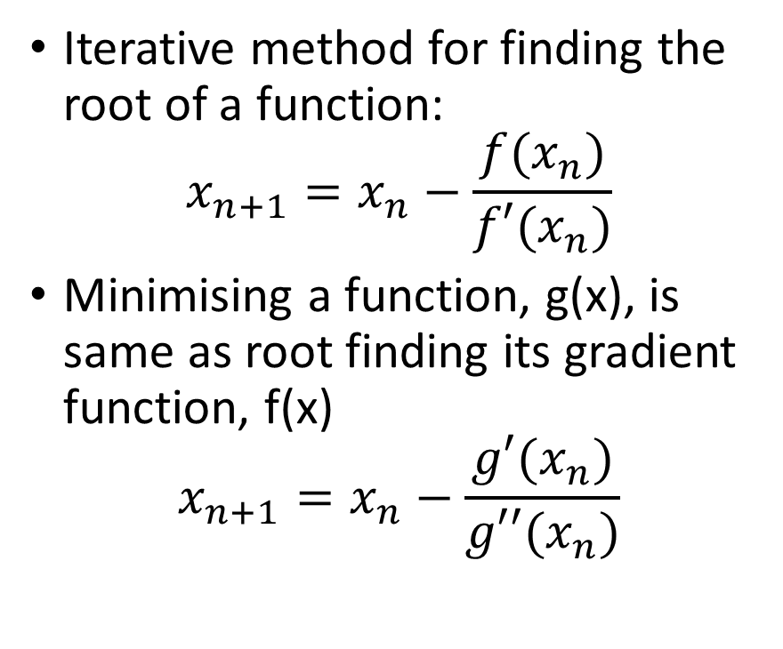
Reminder: Newton-Raphson Method
Iterative method for finding the root of a function:
$$x_{n+1}=x_{n}−\frac{f(x_{n})}{f′(x_{n})}$$
Minimising a function, g(x), is same as root finding its gradient function, f(x)
$$x_{n+1}=x_{n}−\frac{g′(x_{n})}{g′′(x_{n})}$$

Slide 15
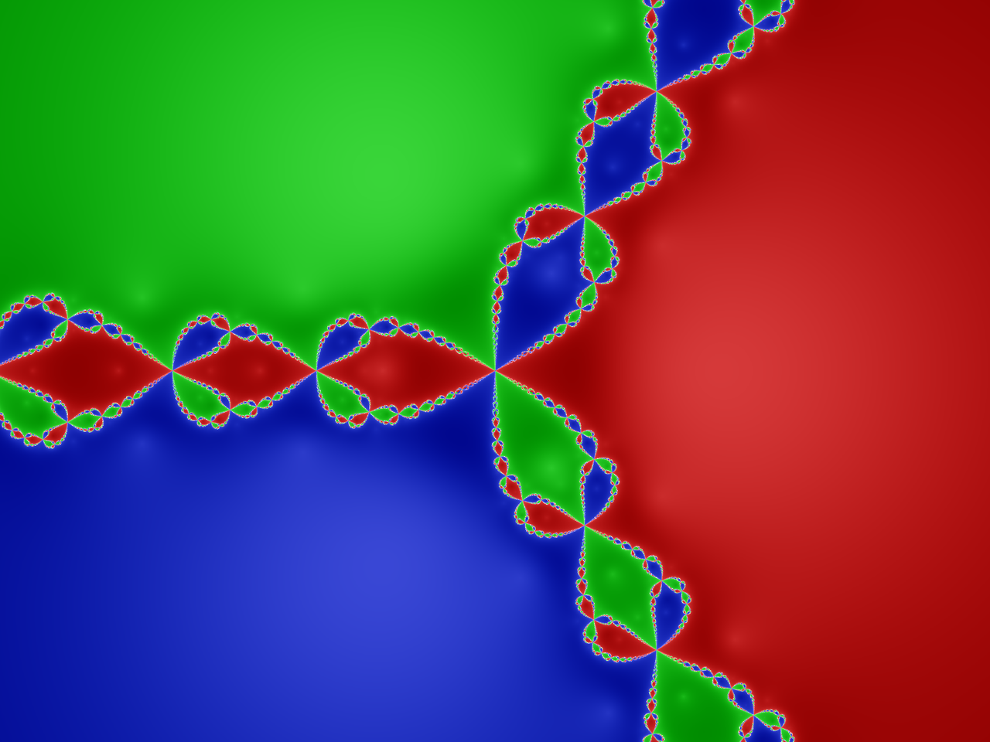
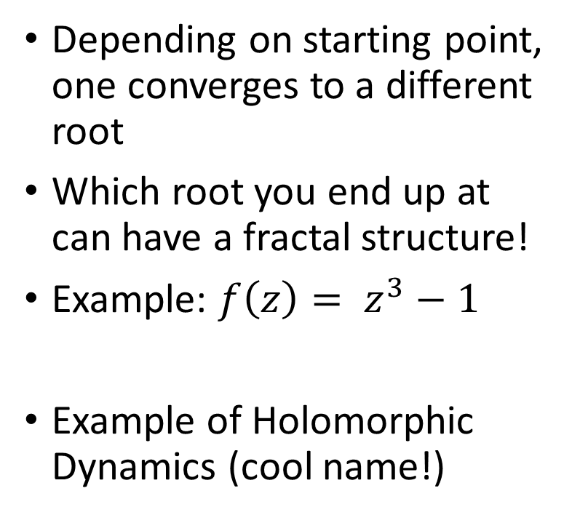
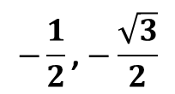
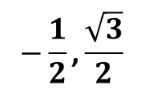
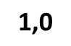
Fun aside: Newton’s Fractal
Depending on starting point, one converges to a different root
Which root you end up at can have a fractal structure!
Example: $f\left(z\right)= z^{3}−1$
Example of Holomorphic Dynamics (cool name!)
$$−\frac{1}{2}\text{,}\frac{\sqrt{3}}{2}$$
$$\text{1,0}$$
$$−\frac{1}{2}\text{,}−\frac{\sqrt{3}}{2}$$

Slide 16
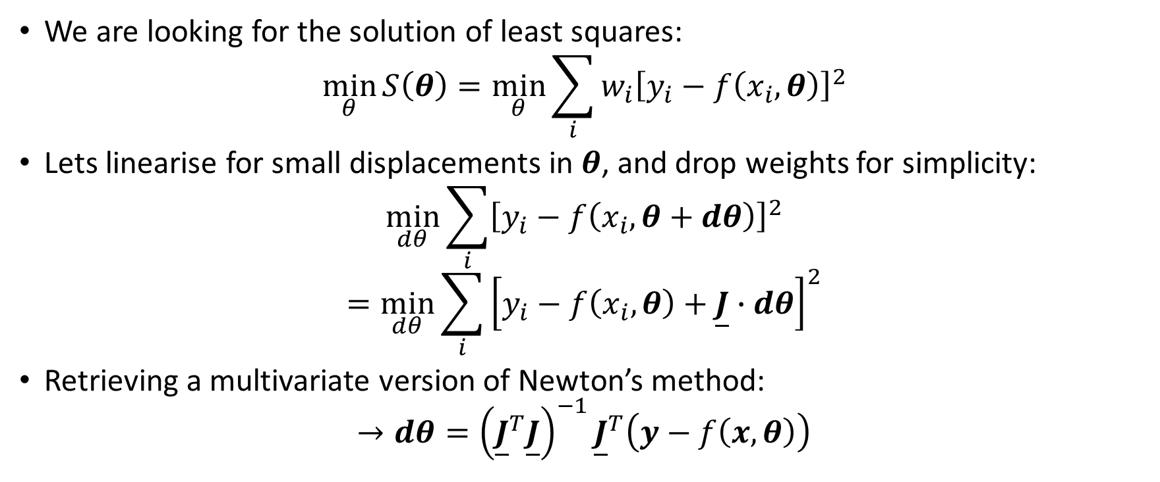
Non-Linear Least Squares
We are looking for the solution of least squares:
$$\min_{θ}{S\left(θ\right)=\min_{θ}\sum_{i}{{w_{i}\left[y_{i}−f\left(x_{i},θ\right)\right]}^{2}}}$$
Lets linearise for small displacements in $θ$, and drop weights for simplicity:
$$\min_{dθ}{\sum_{i}{{\left[y_{i}−f\left(x_{i},θ+dθ\right)\right]}^{2}}}$$
$$=\min_{dθ}{\sum_{i}{{\left[y_{i}−f\left(x_{i},θ\right)+\underline{J}∙dθ\right]}^{2}}}$$
Retrieving a multivariate version of Newton’s method:
$$→dθ={\left({\underline{J}}^{T}\underline{J}\right)}^{−1}{\underline{J}}^{T}\left(y−f\left(x,θ\right)\right)$$
N.B. we have approximated the Hessian as $2{\underline{J}}^{T}\underline{J}$, ignoring all 2nd derivatives, so we can get stuck in saddlepoints!

Slide 17
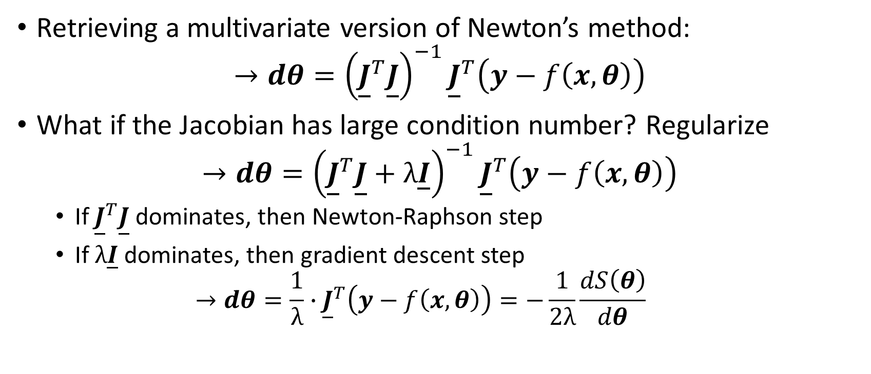
Non-Linear Least Squares
Retrieving a multivariate version of Newton’s method:
$$→dθ={\left({\underline{J}}^{T}\underline{J}\right)}^{−1}{\underline{J}}^{T}\left(y−f\left(x,θ\right)\right)$$
What if the Jacobian has large condition number? Regularize
$$→dθ={\left({\underline{J}}^{T}\underline{J}+λ\underline{I}\right)}^{−1}{\underline{J}}^{T}\left(y−f\left(x,θ\right)\right)$$
If ${\underline{J}}^{T}\underline{J}$ dominates, then Newton-Raphson step
If $λ\underline{I}$ dominates, then gradient descent step
$$→dθ=\frac{1}{λ}∙{\underline{J}}^{T}\left(y−f\left(x,θ\right)\right)=−\frac{1}{2λ}\frac{dS\left(θ\right)}{dθ}$$
N.B. Levenberg-Marquardt algorithm uses the above but adaptively changes $λ$, this is default algorithm in scipy.optimize.curve_fit

Slide 18
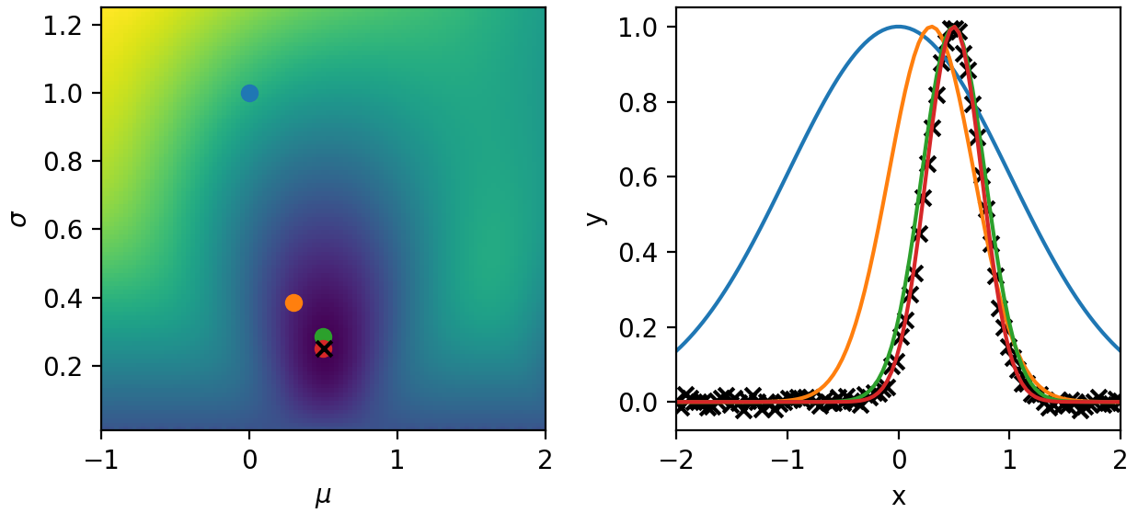

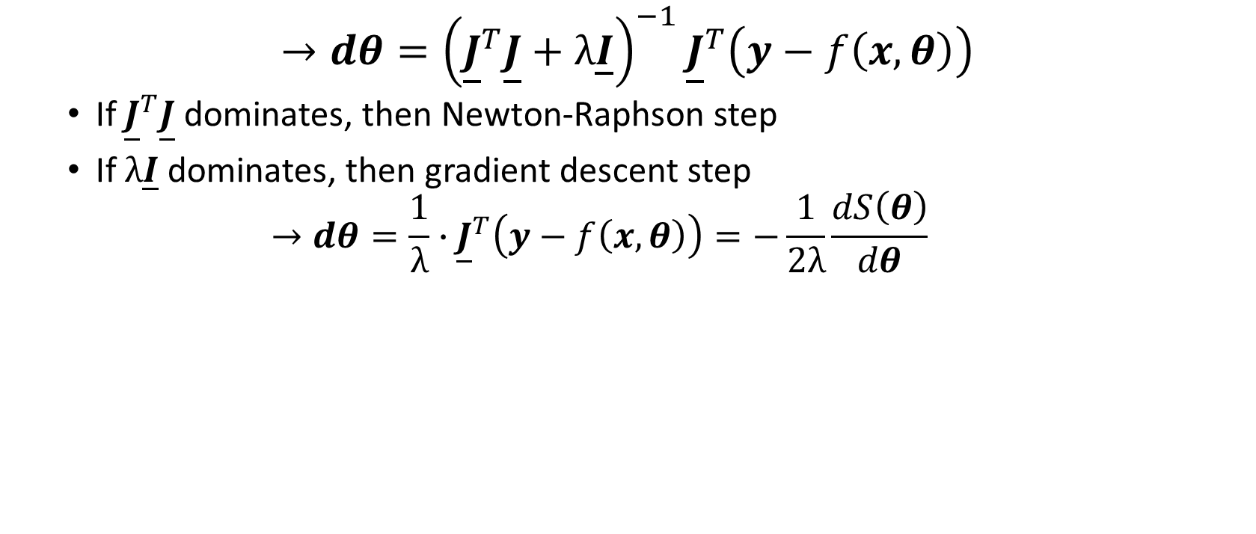
Non-Linear Least Squares
$$→dθ={\left({\underline{J}}^{T}\underline{J}+λ\underline{I}\right)}^{−1}{\underline{J}}^{T}\left(y−f\left(x,θ\right)\right)$$
If ${\underline{J}}^{T}\underline{J}$ dominates, then Newton-Raphson step
If $λ\underline{I}$ dominates, then gradient descent step
$$→dθ=\frac{1}{λ}∙{\underline{J}}^{T}\left(y−f\left(x,θ\right)\right)=−\frac{1}{2λ}\frac{dS\left(θ\right)}{dθ}$$
Newton-Raphson
Gradient Descent

Slide 19
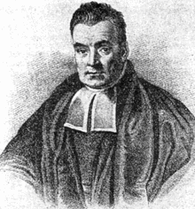
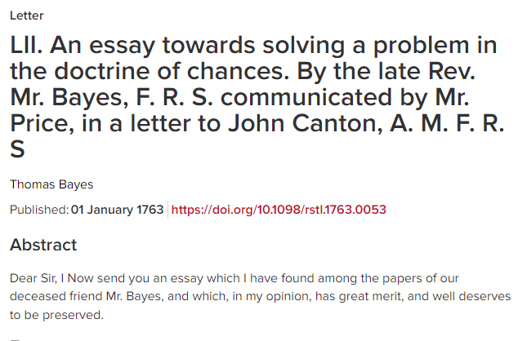
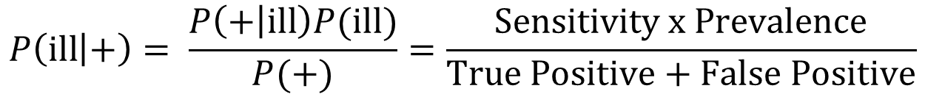
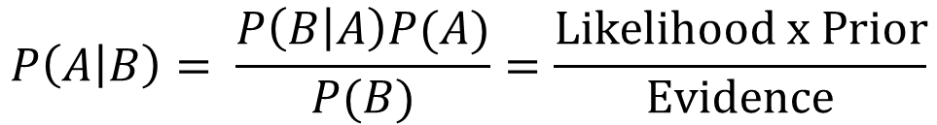
Bayes Theorem and Likelihoods
Bayes’ Theorem states:
Canonical example, medical testing:
Observations always have uncertainty, therefore Bayes rule must be used in parameter estimation
$$P\left(A | B\right)= \frac{P\left(B | A\right)P(A)}{P(B)}=\frac{\text{Likelihood} \text{x} \text{Prior}}{\text{Evidence}}$$
$$P\left(\text{ill} | +\right)= \frac{P\left(+ | \text{ill}\right)P(\text{ill})}{P(+)}=\frac{\text{Sensitivity} \text{x} \text{Prevalence}}{\text{True} \text{Positive}+\text{False} \text{Positive}}$$

Slide 20
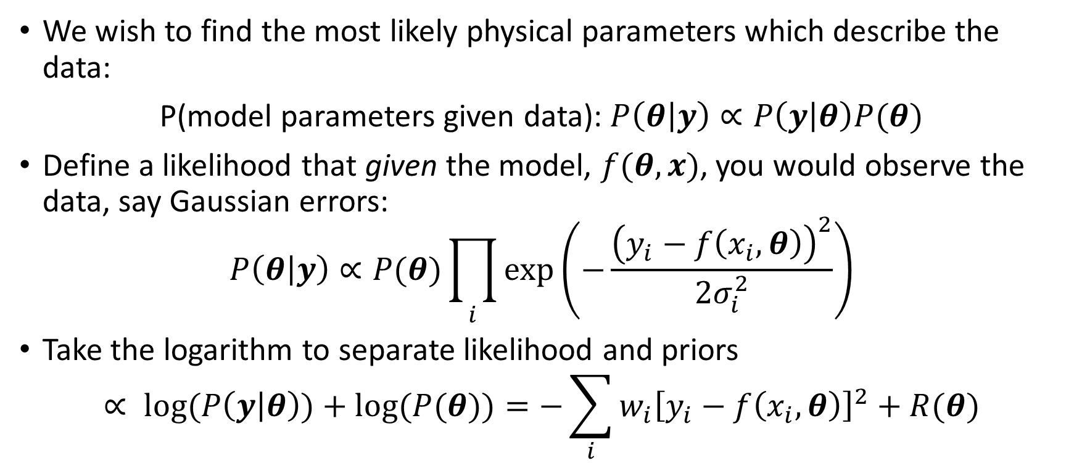
Bayesian Inference
We wish to find the most likely physical parameters which describe the data:
P(model parameters given data): $P\left(θ | y\right)∝P\left(y | θ\right)P(θ)$
Define a likelihood that given the model, $f(θ,x)$, you would observe the data, say Gaussian errors:
$$P\left(θ | y\right)∝P(θ)\prod_{i}{\text{exp}\left(−\frac{{\left(y_{i}−f\left(x_{i},θ\right)\right)}^{2}}{2σ_{i}^{2}}\right)}$$
Take the logarithm to separate likelihood and priors
$$∝ \text{log}\text{(}P\left(y | θ\right)\text{) + }\text{log}\text{(}P(θ))=−\sum_{i}{{w_{i}\left[y_{i}−f\left(x_{i},θ\right)\right]}^{2}}+R(θ)$$
Least squares
Regularisation
Maximal posterior = Minimal least squares

Slide 21
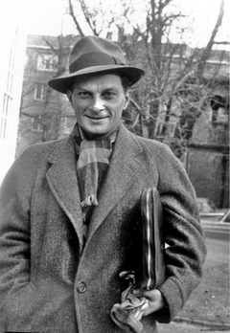
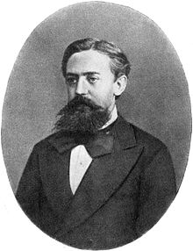
Bayesian Inference: Markov Chain Monte Carlo (MCMC)
We wish to find the posterior distribution of some parameters but we can only evaluate a function proportional to it (Likelihood x Prior)
MCMC: Construct a Markov chain which has an equilibrium distribution of the posterior
70%
Markov chain:
A sequence of possible events where the next state only depends on the current state
Monte Carlo:
A class of numerical algorithm which involves repeated random sampling
70%
30%
70%
30%
30%

Slide 22
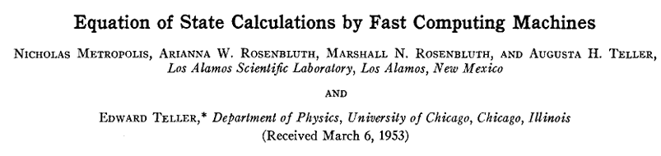
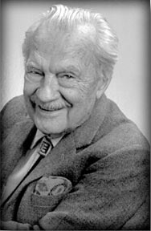
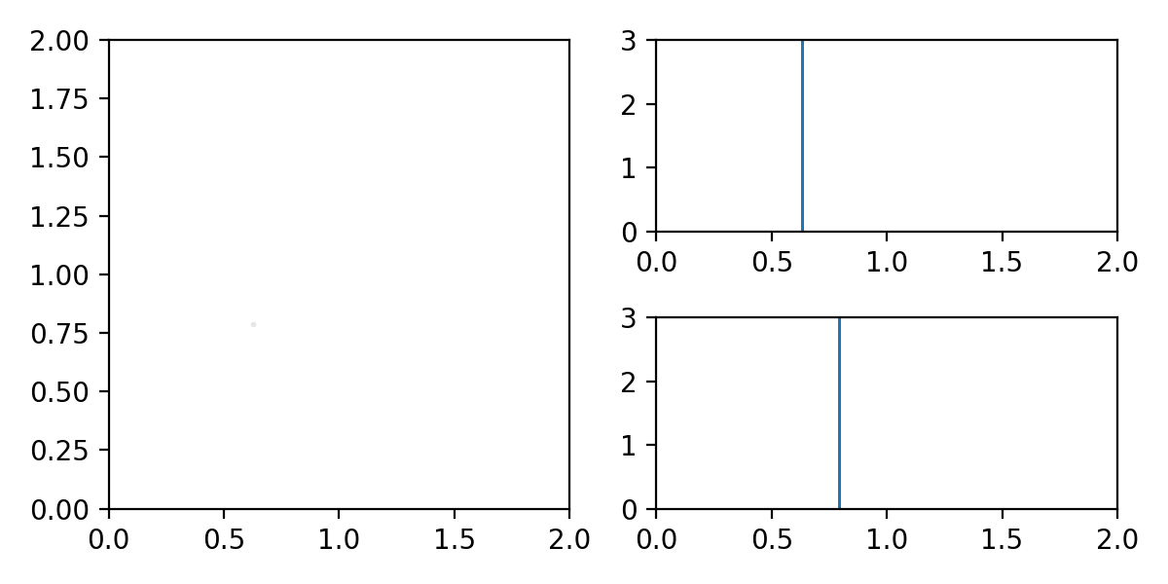
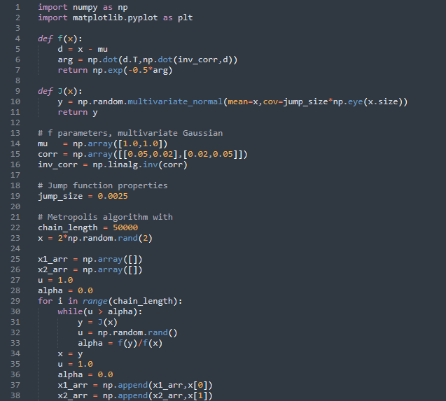
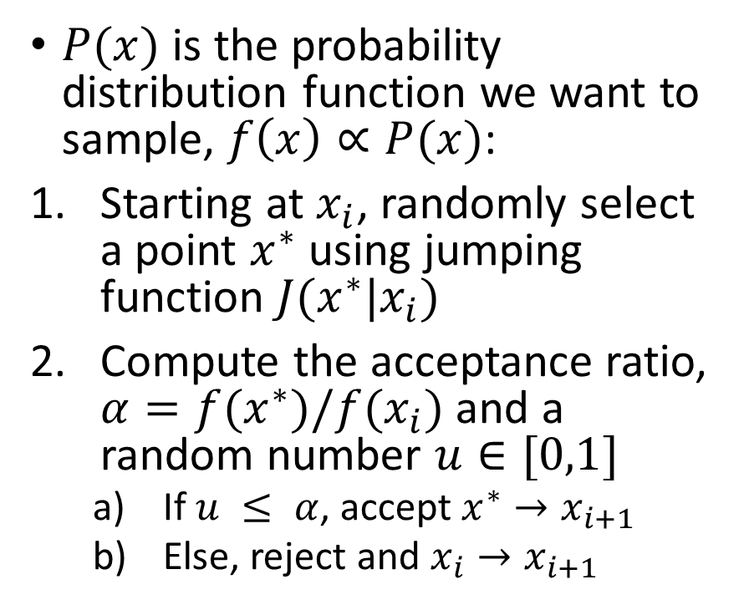
Metropolis-Hastings Algorithm
$P(x)$ is the probability distribution function we want to sample, $f\left(x\right)∝P(x)$:
Starting at $x_{i}$, randomly select a point $x^{∗}$ using jumping function $J(x^{∗}|x_{i})$
Compute the acceptance ratio, $α=f(x^{∗})/f(x_{i})$ and a random number $u∈[0,1]$
If $u ≤ α$, accept $x^{∗}→x_{i+1}$
Else, reject and $x_{i}→x_{i+1}$

Slide 23
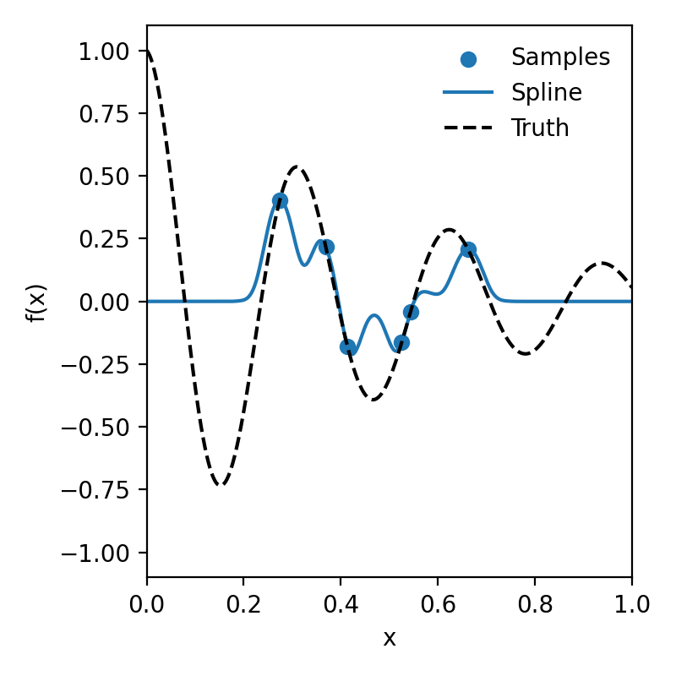
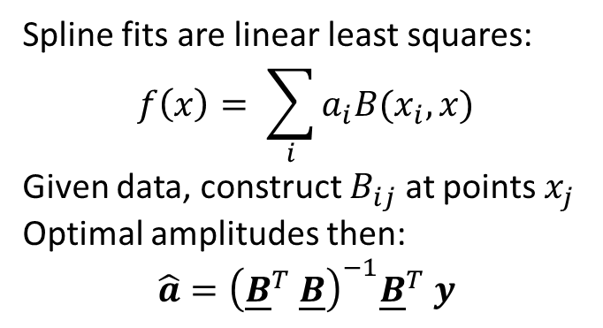
Non-Parametric Regressors
In the absence of a parametric model, one might want a generic fitting model
Increasing in various levels of complexity:
Nearest-neighbour interpolation
Splines
Gaussian processes
Fitting function modifies as you introduce more data? That’s a nonparametric regressor
Spline fits are linear least squares:
$$f\left(x\right)= \sum_{i}{a_{i}B(x_{i},x)}$$
Given data, construct $B_{ij}$ at points $x_{j}$
Optimal amplitudes then:
$$\hat{a}={\left({\underline{B}}^{T} \underline{B}\right)}^{−1}{\underline{B}}^{T} y$$

Slide 24
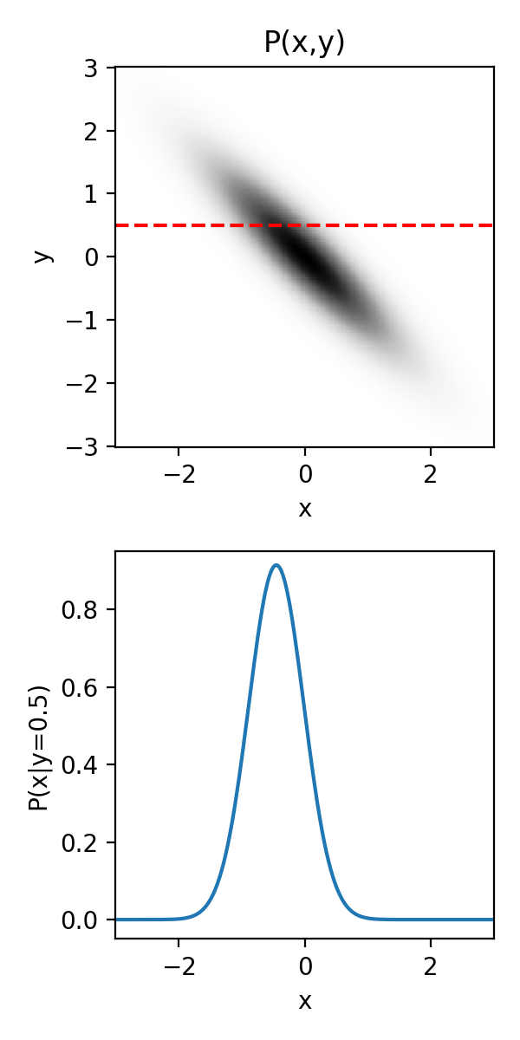
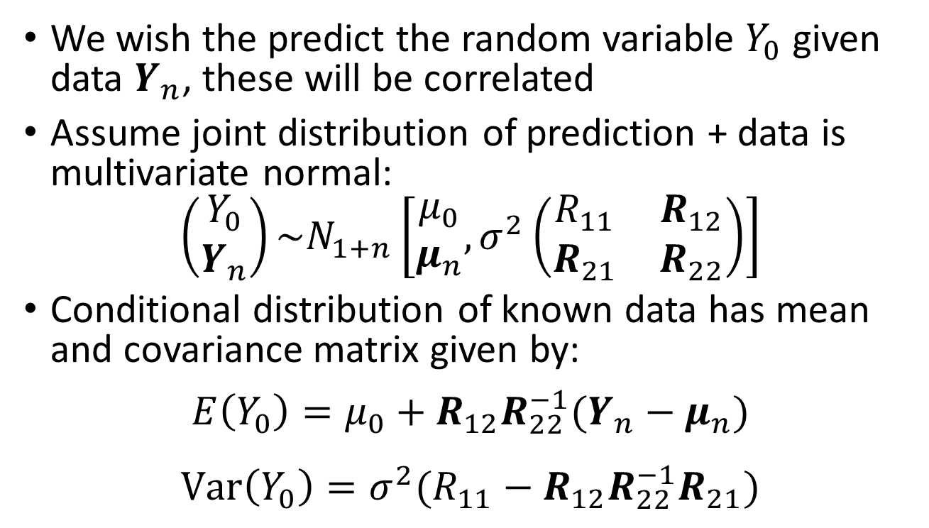
Conditioning multivariate normals
We wish the predict the random variable $Y_{0}$ given data $Y_{n}$, these will be correlated
Assume joint distribution of prediction + data is multivariate normal:
$$\left(\begin{matrix}Y_{0} \\ Y_{n}\end{matrix}\right)\sim N_{1+n}\left[\begin{matrix}μ_{0} \\ μ_{n}\end{matrix},σ^{2}\left(\begin{matrix}R_{11} & R_{12} \\ R_{21} & R_{22}\end{matrix}\right)\right]$$
Conditional distribution of known data has mean and covariance matrix given by:
$$E\left(Y_{0}\right)=μ_{0}+R_{12}R_{22}^{−1}(Y_{n}−μ_{n})$$
$$Var\left(Y_{0}\right)=σ^{2}(R_{11}−R_{12}R_{22}^{−1}R_{21})$$
For more detail see: The Design and Analysis of Computer Experiments by Santner, Williams and Notz

Slide 25
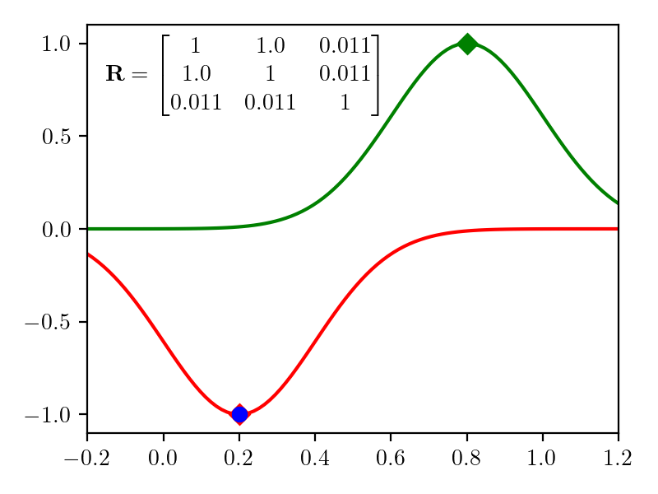
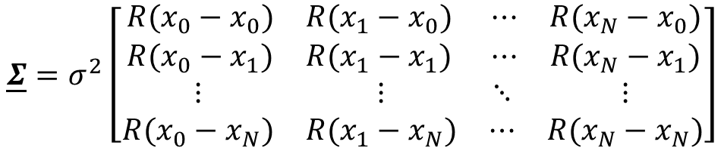
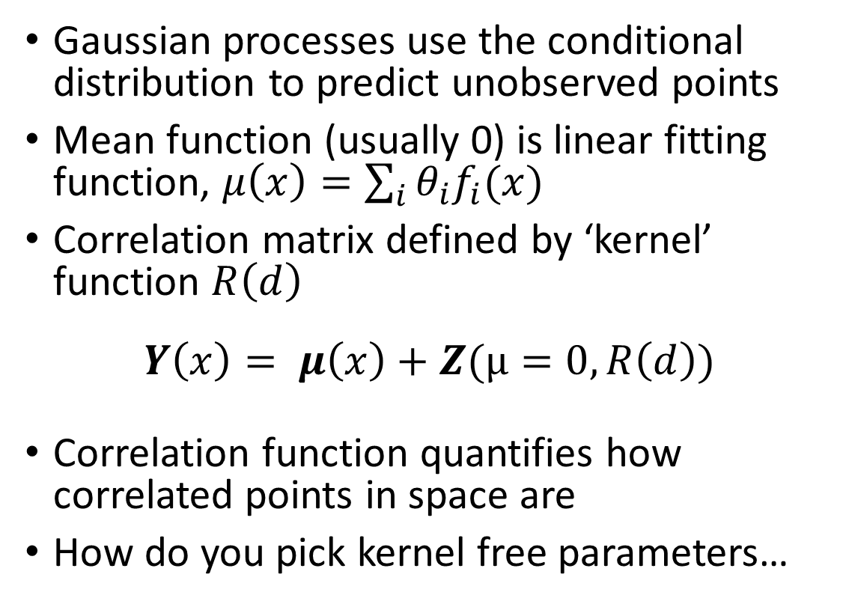
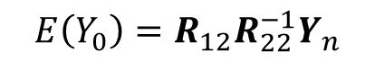
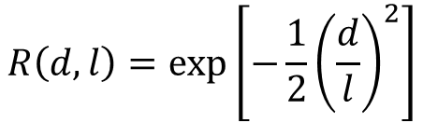
Gaussian Processes
$$\underline{Σ}=σ^{2}\left[\begin{matrix}\begin{matrix}R(x_{0}−x_{0}) & R(x_{1}−x_{0}) \\ R(x_{0}−x_{1}) & R(x_{1}−x_{1})\end{matrix} & \begin{matrix}⋯ & R(x_{N}−x_{0}) \\ ⋯ & R(x_{N}−x_{1})\end{matrix} \\ \begin{matrix}⋮ & ⋮ \\ R(x_{0}−x_{N}) & R(x_{1}−x_{N})\end{matrix} & \begin{matrix}⋱ & ⋮ \\ ⋯ & R(x_{N}−x_{N})\end{matrix}\end{matrix}\right]$$
Gaussian processes use the conditional distribution to predict unobserved points
Mean function (usually 0) is linear fitting function, $μ\left(x\right)=\sum_{i}{θ_{i}f_{i}(x)}$
Correlation matrix defined by ‘kernel’ function $R\left(d\right)$
$$Y\left(x\right)= μ\left(x\right)+Z(μ=0,R\left(d\right))$$
Correlation function quantifies how correlated points in space are
How do you pick kernel free parameters…
$$E\left(Y_{0}\right)=R_{12}R_{22}^{−1}Y_{n}$$
$$R\left(d,l\right)=\text{exp}\left[−\frac{1}{2}{\left(\frac{d}{l}\right)}^{2}\right]$$

Slide 26
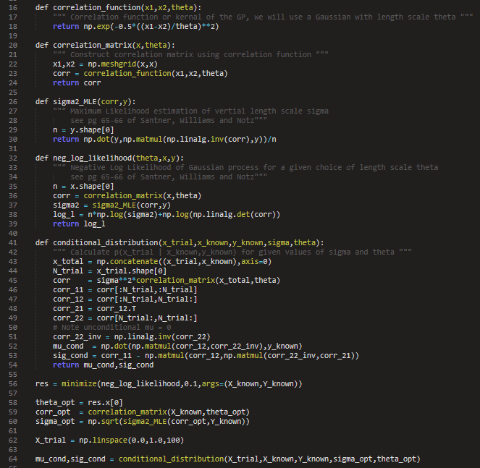
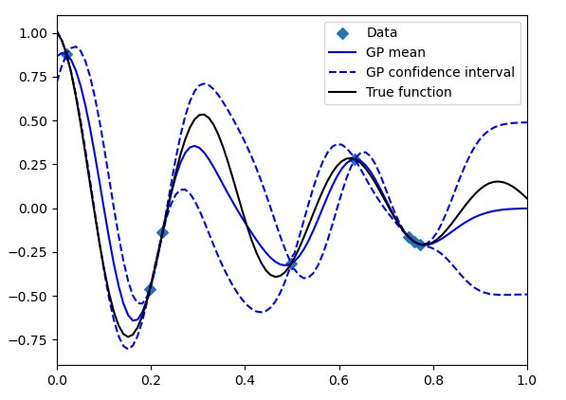
Gaussian Processes: Example
Kernel parameters found by maximal likelihood estimation given known data
Python libraries: Gpy, sklearn

Slide 27







Neural Networks
Neural networks are canonical AI model
They are black-box functions with many, many learnable parameters, ChatGPT 175 billion
Many flavours, we will discuss the multi-layer perceptron (MLP)
Basic unit is the neuron:
Neuron properties: Parameters: weight $w$, bias $b$
Activation function: tanh, ReLU, etc.
Input: $x$
Output: $y$
$$x^{′}= wx+b$$
$$y$$

Slide 28






Multi-Layer Perceptron
Stack neurons into layers and fully-connect layers
Define loss function between predicted and real outputs e.g. mean-squared-error (MSE)
Update neuron parameters by gradient descent (or variations of it)
It is just regularised non-linear least squares again!
$$dθ=α∙{\underline{J}}^{T}\left(y−f\left(x,θ\right)\right)$$
Various optimisers
Loss
$$θ_{2}$$
$$θ_{1}$$
Learning rate
Jacobian found by AD
Neural network

Slide 29



Neural Networks: Example
Learn relationship between Si IAW Thomson scattering features and physical parameters
$$θ=(n_{e},μ,T_{e},T_{i},Z,v_{fi},v_{fe})$$
$$y=({∆λ}_{m},{∆λ}_{h}−{∆λ}_{l},a_{λ})$$
Selection of the NN architecture can be human judgement or algorithmic
Tweaking of model parameters becomes tweaking of hyper-parameters
Data ‘featurisation’ is often key in producing a good model
1,411 trainable parameters

Slide 30






Neural Networks: Example
Learn relationship between Si IAW Thomson scattering features and physical parameters
$$θ=(n_{e},μ,T_{e},T_{i},Z,v_{fi},v_{fe})$$
$$y=({∆λ}_{m},{∆λ}_{h}−{∆λ}_{l},a_{λ})$$
Deep learning libraries: keras/tensorflow, sklearn, pytorch
$${∆λ}_{m}$$
$${∆λ}_{h}−{∆λ}_{l}$$
$$a_{λ}$$
https://gb.coursera.org/learn/neural-networks-deep-learning

Slide 31



Examples in the field
Surrogate model of secondaries in MagLIF
Transfer learning in ICF experiments
Calibration-driven deep emulators

